Slide 1
Lecture 20 October 18, 2019
Today we start the second half of the course.
Midterms submitted include 171* points possible:
Exams 1 and 2=100 points
Lab report 1 and 2=40 points
Lab quiz 1= 26 points
Popquiz (genotype probability)=5 pts.
10 pts EC was available

Slide 2
Try the blood typing game at: Nobelprize.org
http://educationalgames.nobelprize.org/educational/medicine/bloodtypinggame/?_ga=2.8813941.1992818736.1571654943-1261635598.1570617180

Slide 3
Where were we?....
Extensions of Mendel’s observations…
Genes with multiple variations (alleles) in the population. Discussed Drosophila white locus and mammalian MHC genes.
So much variation of these MHC genes is good for health immune responses, but not good for organ transplant.

Slide 4
The need for unrelated donors…for organs, including bone marrow (Next semester--- bone marrow registry drive)

Slide 5
Extension #6
Lethal alleles
In some matings we may see non-Mendelian ratios if some of the offspring fail to survive development.
This hints at the involvement of an essential gene for development/survival. Mutant forms appear to be lethal.

Slide 6
Noted in an interesting cross of mice with variation in fur color…
Wild type color= agouti (yellow pigment deposited on a black hair shaft)
Wild type allele (for color)=A
Dominant mutation (A^{y}) results in yellow fur.
What do you expect for color ratio in a cross of 2 yellow mice (heterozygotes)? A A^{y} X A A^{y}

Slide 7
 | A | A^{y}
A | AA | AA^{y}
A^{y} | AA^{y} | A^{y}A^{y}
Expect?...3 yellow: 1 agouti

Slide 8
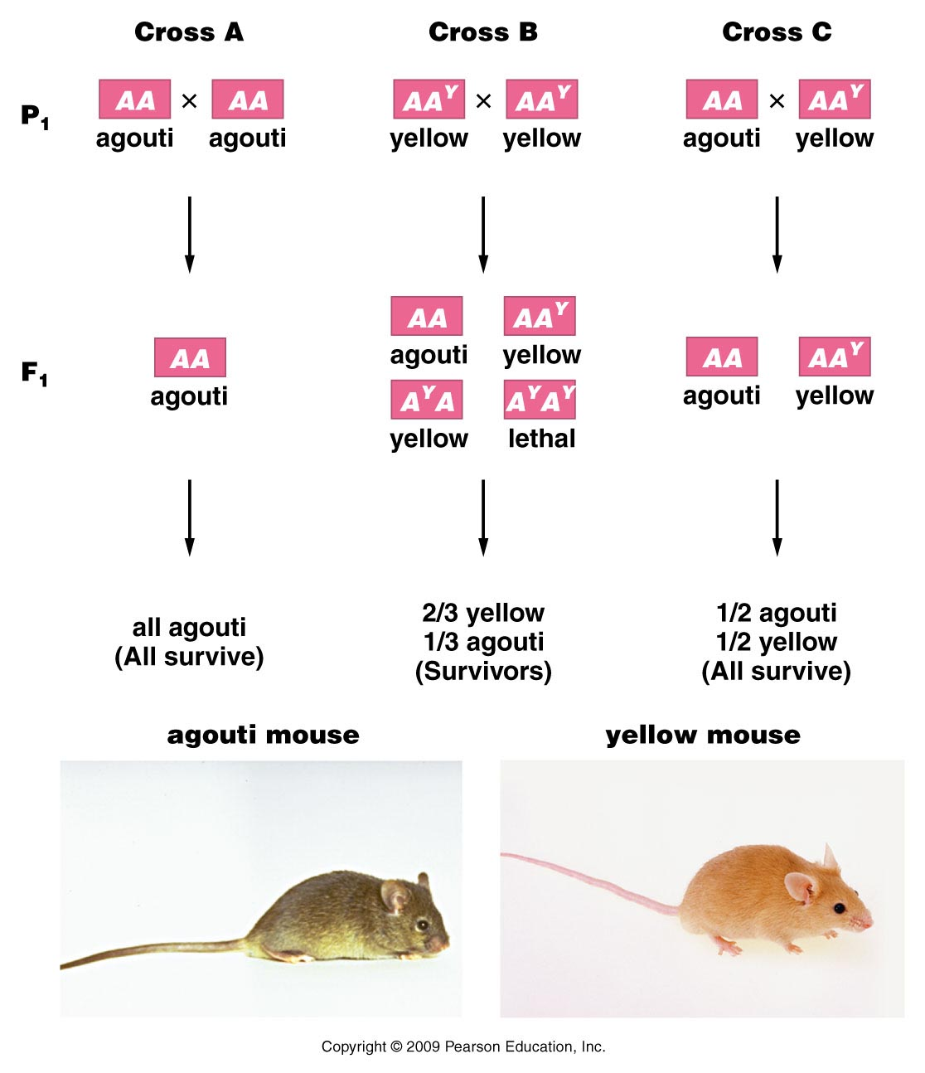
Figure 4.4
Notes:
Figure 4-4 Inheritance patterns in three crosses involving the normal wild-type agouti allele (A) and the mutant yellow allele (A^{Y}) in the mouse. Note that the mutant allele behaves dominantly to the normal allele in controlling coat color, but it also behaves as a homozygous recessive lethal allele. The genotype A^{Y} A^{Y} does not survive.

Slide 9
observe~2 yellow:1 agouti
Compared to Mendel’s observations, missing about ¼ of the yellow offspring
Explanation…looks like the A^{y} A^{y} genotype which we expect to be yellow, is also a lethal genotype.
(A^{y} is called a recessive lethal allele). Mice with this genotype die before they are born. They are not observed in the offspring.

Slide 10
Molecular mechanism?...
Nothing to do with yellow fur!
Y mutation/allele is really a large deletion of a chromosome region (which affects regulation of yellow pigmentation)
AND.. which affects the nearby gene called merc. The merc gene product is essential for normal development—so in A^{y} A^{y} mice, the wild type merc alleles are lost in both chromosomes.

Slide 11
Lethal alleles…
Can be recessive or dominant
Recessive A^{y} A^{y}
Dominant (Huntington allele) Hh—get Huntington disease and eventually die from it
Can be expressed before or after birth (A^{y} A^{y} is embryonic lethal; Hh is lethal in adulthood)
*We will discuss variable onset of phenotypes soon.

Slide 12
Extension #6
Traits controlled by 2 or more genes.
Drosophila eye color
ABO blood type (we didn’t tell the whole story!)
Labrador retriever color
Many more!!!

Slide 13
When a trait is controlled by more than one gene, we have to consider genotypes at 2+ loci to determine a single phenotype.
Let’s start with something familiar---ABO blood type…(there is more to inheritance than we first thought)

Slide 14
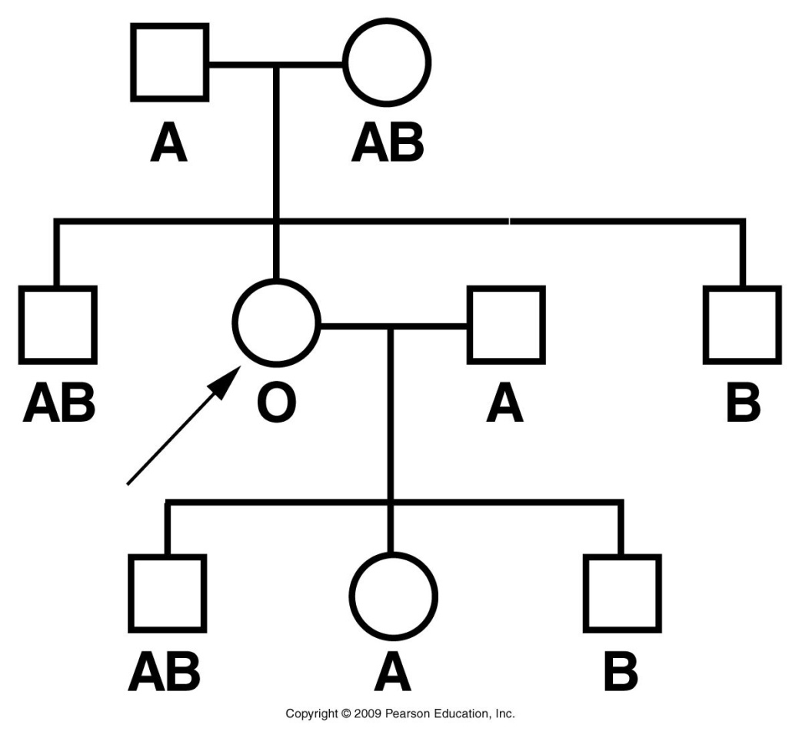
What is wrong with this pedigree? Explain every inconsistency.
Figure 4.3
Notes:
Figure 4-3 A partial pedigree of a woman displaying the Bombay phenotype. Functionally, her ABO blood group behaves as type O. Genetically, she is type B.

Slide 15
Proband—a woman in Bombay ( now called Mumbai) India.
Blood testing showed no A or B antigens on her rbc, despite having parents A and AB.
She had a son and daughter who clearly inherited an I^{B} allele from her.

Slide 16
Her O blood type was not the result of IºIº genotype.
She had a recessive mutation in a second gene called Fut1. Fut1 encodes a protein which controls the production of a substrate to which A and B antigens attach.
Substrate is called: H substance

Slide 17
The recessive h allele is so rare that nearly everyone makes H substance (very few hh individuals).
Was not realized that a second gene was involved in ABO expression until this “Bombay Phenotype” was recognized.

Slide 18
Bombay phenotype is an example of:
Epistasis—In epistasis, the expression of one gene masks or modifies expression of another gene.
We’ll return to this…

Slide 19
Drosophila eye color…again there’s more to the story
Wild type eye color=brick red.
Result of 2 pigment proteins whose production is controlled by 2 different genes.
What we see is the combination of a bright red pigment and a brown pigment deposited together.

Slide 20
In this case, we might expect more than the 2 variations that Mendel saw in pea traits…

Slide 21
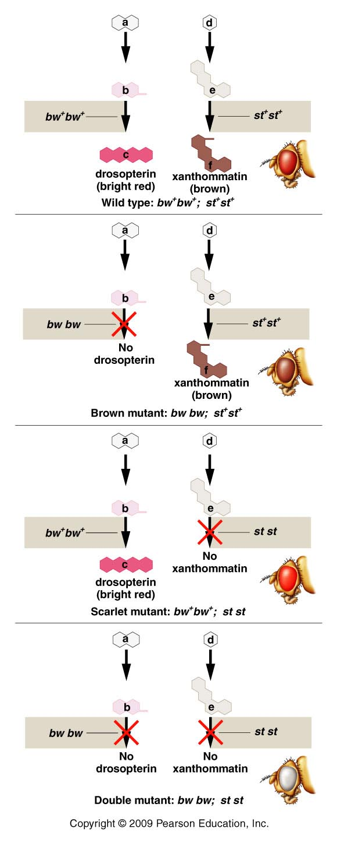
4 variations!
Variation in eye color can be explained by the presence or absence of the 2 pigments.
brick red
brown
bright red
And remember—there are 100s of variations of the white allele
white
Figure 4.10
Notes:
Figure 4-10 A theoretical explanation of the biochemical basis of the four eye-color phenotypes produced in a cross between Drosophila with brown eyes and scarlet eyes. In the presence of at least one wild-type bw⁺ allele, an enzyme is produced that converts substance b to c, and the pigment drosopterin is synthesized. In the presence of at least one wild-type st⁺ allele, substance e is converted to f, and the pigment xanthommatin is synthesized. The homozygous presence of the recessive bw and st mutant alleles blocks the synthesis of these respective pigment molecules. Either one, both, or neither of these pathways can be blocked, depending on the genotype.

Slide 22
What ratio of phenotypes would you expect from a cross of 2 wild-type heterozygotes?
Red pigment (R gene)
Brown pigment (B gene)
Assume a recessive genotype results in no pigment.
RrBb X RrBb 16 box punnett square ?

Slide 23
Dihybrid ratio!
9 R__B__ brick red (wild type)
3 R__bb bright red
3 rr B__ brown
1 rrbb white
9:3:3:1

Slide 24
1 trait controlled by 2 genes– what might give it away?...
More than 2 variations
A dihybrid ratio or (modified dihybrid ratio---see next example) in a cross involving one trait, indicates 2 genes control the trait.

Slide 25
Another 2-gene trait Labrador retriever color…
Pure breeding black and pure breeding yellow mate
Black labs (from different black and yellow parents)
Theoretical ratio:
9 black: 3 brown(chocolate) :4 yellow
(ratio is in 16ths)

Slide 27
Explanation?...
Looks very similar to dihybrid ratio---modified dihybrid ratio.
9:3:4 =9:3:(3 +1)
Coat color controlled by 2 genes. (A and B)
a recessive genotype for one of the genes masks the expression of the other gene.

Slide 28
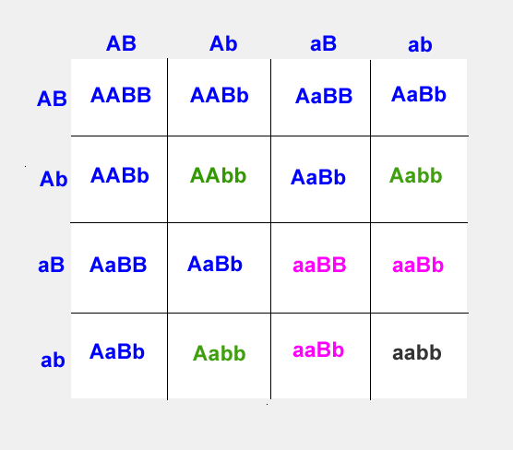
AaBb X AaBb
A_B_ =black
A_bb = brown
aaB_ =yellow
aabb= yellow

Slide 29
Molecular mechanism?
B gene controls production of pigment. Black is dominant to brown.
B_ = black pigment
bb = brown
A second gene, A, controls expression of any pigment.
A_ (allows proper expression of the B/b alleles)
aa (masks expression of B/b alleles---fur appears yellow/white)

Slide 30
9:3:4 (3+1) is an indication that a trait is controlled by 2 genes and shows recessive epistasis.
Mouse coat color works similarly---see p.83
3 coat colors Agouti, black and white (albino)

Slide 31
Dominant epistasis…
Similar phenomenon, but in this case a dominant allele masks/modifies expression of a second gene.
Summer squash color.
Controlled by 2 genes, A and B
Gene B controls color-- yellow is dominant to green.
Dominant A allele give white fruit regardless of alleles of second gene B

Slide 32
Prediction?
Cross 2 heterozygous plants giving white squash
AaBb X AaBb
9 A__B__
3 A__bb
3 aa B__
1 aa bb

Slide 33
Prediction?
Cross 2 heterozygous plants giving white squash
AaBb X AaBb
9 A__B__
3 A__bb 12 white
3 aa B__ 3 yellow
1 aa bb 1 green

Slide 34
12:3:1 common indicator of dominant epistasis.
Molecular mechanism? Squash color is controlled by a gene (B) where yellow is dominant over green. A dominant allele of a second gene (A) overrides pigment production of any genotype at the (B) gene.

Slide 35
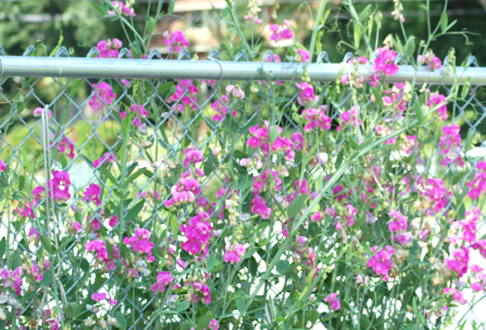
Another example of a 2-gene trait
Flower color in sweet pea (not garden pea)
Observed by William Bateson and Reginald Punnett—Yes he did experiments, not just squares!

Slide 36
Experiment..
Crossed 2 true-breeding strains of white-flowered sweet peas
F1 All purple!
F2 9 purple:7 white

Slide 37
Explanation?
9:7 ratio
Ratio in 16th s suggests 2 genes
9 A__B__
3 A__bb
3 aa B__
1 aa bb
Bateson and Punnet proposed that purple flowers require both genes must have at least one dominant allele.

Slide 38
9 A__B__ purple
3 A__bb
3 aa B__ white
1 aa bb
Proposed mechanism of biochemical pathway…
gene A gene B
pigment precursor intermediate product final product
(colorless) (colorless) (purple pigment)

Slide 39
Sweet pea color genes give an example of 2 mutant alleles causing the same phenotype.
aaB_
A_bb white due to aa or bb genotype (Due
Aabb a lack of wild-type A or B allele)

Slide 40
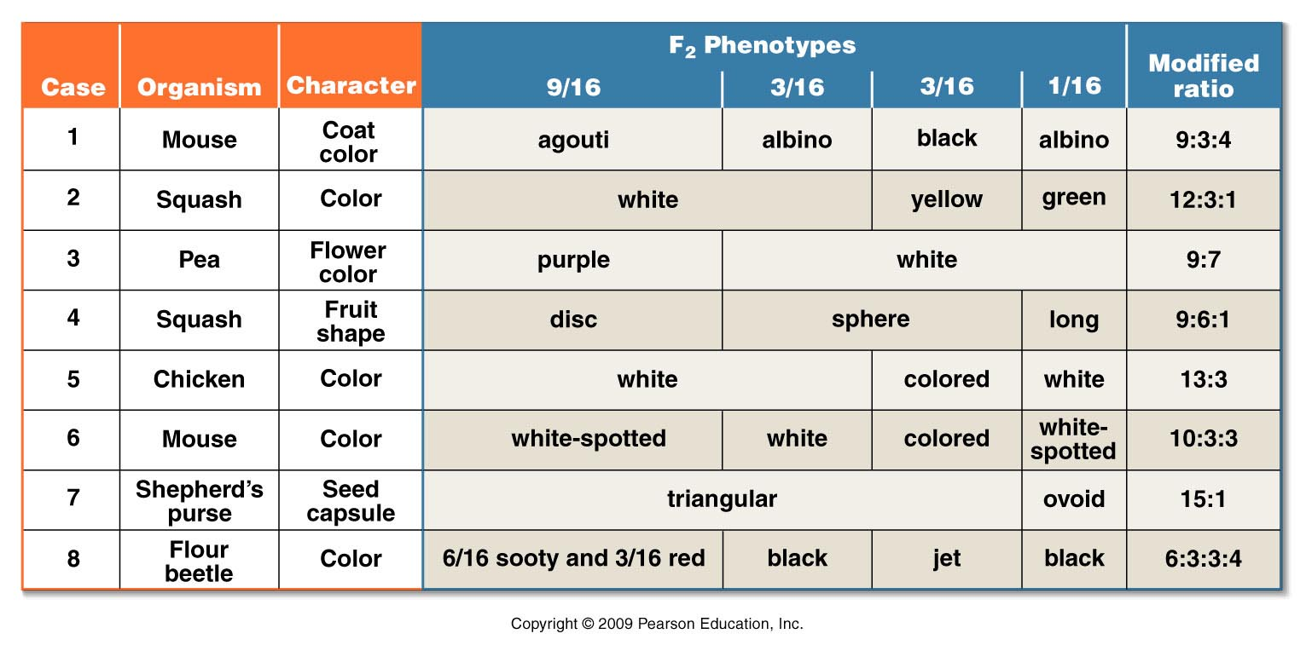
Examples of other modified dihybrid ratios (2 gene traits)
Try coming up with “molecular explanations” for some of these modified dyhibrid ratios!
Figure 4.8
Notes:
Figure 4-8 The basis of modified dihybrid F² phenotypic ratios, resulting from crosses between doubly heterozygous F¹ individuals. The four groupings of the F² genotypes shown in Figure 4–7 and across the top of this figure are combined in various ways to produce these ratios.

Slide 41
How might you notice a trait controlled by 3 interacting genes?

